Slide 1
Cash Flow Management During a Pandemic
A Short Introduction for Small Business Owners
Chris Reed, San Juan County SCORE

Slide 2
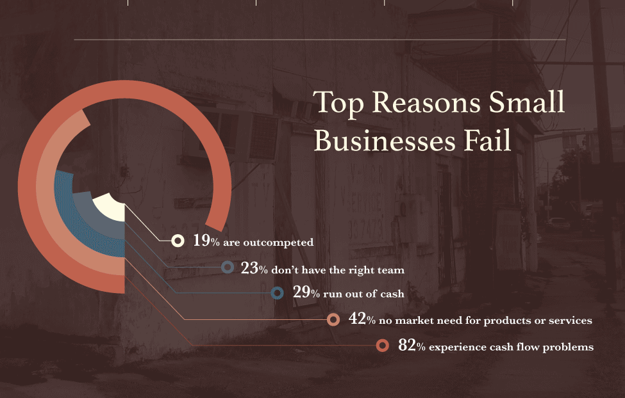

Slide 3
“Cash is King”
Managing cash flow is one of the most important tasks for the owner of a small business
Poor Cash Flow Management can doom an otherwise viable business
Income is often variable/seasonal, many expenses are not
Disappointing results, external shocks (pandemic) can stress the best plans
Forecasting Cash Flow needs helps you protect against failure
Building appropriate levels of cash reserves
Managing expenses and labor appropriately – setting action triggers
Securing credit lines / grants as needed

Slide 4
Financial Statements: Overview
Orders and Activities
Income
Statement
Balance
Sheet
Cash Flow
Transactions occur throughout the period
Income Statement records financial impact during the period
Balance Sheet captures snapshot of assets & liabilities at a point in time
Cash Flow Statement shows the cash effects of income statement events and balance sheet changes
4

Slide 5
Cash Flow Statement
The Cash Flow Statement shows the flows of cash – in and out – during the period
All the items on the cash flow statement relate directly back to the income statement or the balance sheet
There are three distinct types of cash flows
Cash flow from operations
Cash flow from investment activities
Cash flow from financing activities
The “bottom line” of the Cash Flow Statement is the Net Change in Cash, which shows whether the business was a net generator or user of cash
Note carefully that a business can be profitable but put itself out of business by requiring too much cash
5

Slide 6
A SAMPLE CASH FLOW STATEMENT
Starting Cash 18000
Cash Flow from Operations
Net profit 5000
Add back depreciation 1000
Decrease in A/R - 2000
Decrease in Inventory - 1000
Increase in A/P 2000
Increase in Accrued Payroll 1000
Net Cash from Operations 6000
Cash Flow from Investment Activities
Purchase of Equipment - 3000
Net Cash from Investments - 3000
Cash Flow from Financing Activities
Increase in Loan - 1000
Net Cash from Financing - 1000
Total Net Cash Flow +2000
Ending Cash 20000
Income Statement |  |  | Balance Sheet |  | Start | End | Change
Revenue |  |  | Assets
Sales | 55,000 |  | Cash |  | 18,000 | 20,000 | 2,000
Commissions | 5,000 |  | Accounts Receivable |  | 18,000 | 20,000 | 2,000
Net Revenue | 50,000 |  | Inventory |  | 29,000 | 30,000 | 1,000
 |  |  | PP&E |  | 28,000 | 30,000 | 2,000
Cost of Goods Sold
Direct Material | 20,000 |  | Total Assets |  | 93,000 | 100,000 | 7,000
Direct Labor & Benefits | 10,000
Cost of Goods Sold | 30,000
Gross Profit | 20,000
Operating Expenses |  |  | Liabilities
Salaries and Benefits | 5,000 |  | Accounts Payable |  | 3,000 | 5,000 | 2,000
Rent | 3,500 |  | Accrued Payroll |  | 2,000 | 3,000 | 1,000
Advertising | 2,500 |  | Bank Debt |  | 21,000 | 20,000 | -1,000
Supplies and other | 2,500 |  | Total Liabilities |  | 26,000 | 28,000 | 2,000
Total Operating Expenses | 13,500
 |  |  | Owner's Investment |  | 50,000 | 50,000 | 0
Profit from Operations (EBITDA) | 6,500 |  | Accumulated Profits |  | 17,000 | 22,000 | 5,000
 |  |  | Total Shareholders' Equity |  | 67,000 | 72,000 | 5,000
Non-Operating Expenses
Interest Expense | 500 |  | Total Liabilities + Equity |  | 93,000 | 100,000 | 7,000
Depreciation | 1,000
Net Profit | 5,000
6
Notes:
Color-coded to show where the numbers come from

Slide 7
Cash Flow Forecast – Bank Balance
“Typical” Island Seasonal Business (normal times)
+
-
Jan Apr Jul Dec
7

Slide 8
Cash Flow Forecast – Bank Balance
+
Resilience Financing
2020?
-
Working Capital Needs
Delaying expenses, securing grants & loans
Jan Apr Jul Dec
8

Slide 9
Your Key Task
Figure out how to survive and ultimately prosper without permanently hobbling your business
Build Several Spreadsheet Scenarios – P&L, Cash Flow
“Low Impact” - modest, short-term impacts
“High Impact” – larger impacts over 2-3 years
Craft a strategy now to lower business costs and secure necessary cash for “High Impact”, if needed
Resilience Analysis: what is your revenue threshold for long term viability?

Slide 10
Pandemic Cash Resources
Grants / Forgiveness
Landlords / Rent
EIDL / EEIG
$1000/ee, $10000 max
PPP
33% payroll x 2 mos
Employee Retention Credit
50% payroll for Q2, Q3?
Deferrals / Loans
Landlords / Rent
Utilities
Taxes
EIDL Loan
3.75%, 12mo deferral
~ 6mo working capital
PPP Loan*
1 %, 6 mo deferral
2.5x payroll
SBA 7a Loans
Some Credit Cards
Commercial Lenders
* Usage rules still unclear

Slide 11
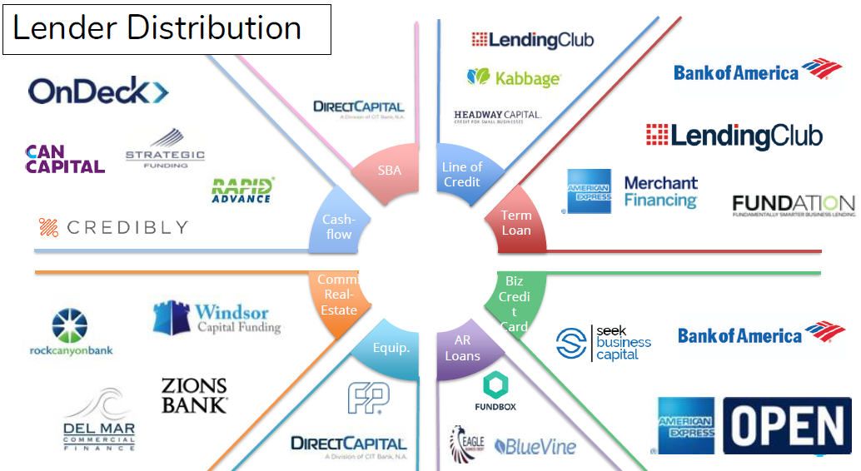
Some Commercial Options

Slide 12
Some Resources to Figure This Out
Your business advisors
Your Banker
SCORE
Webinars & other resources
Free Business Mentoring
chris.reed@scorevolunteer.org

